Slide 1
This slide is hidden.
Insert the starting slides after this slide

Slide 2
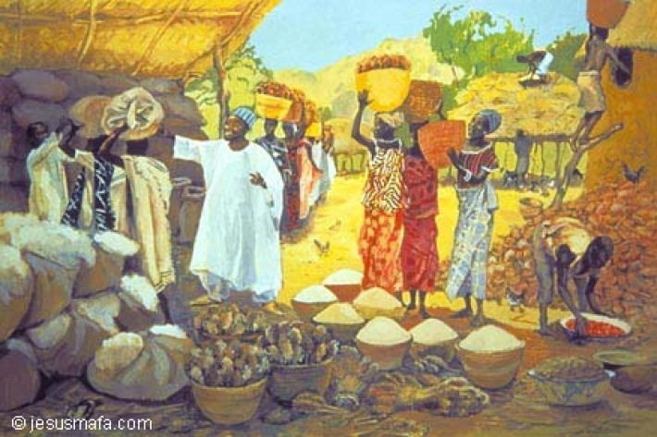
Welcome to St Michael’s
18th Sunday in Ordinary Time Year C
Please ensure all mobile phones are switched off.
Please be respectfully quiet as we prepare for our Celebration.
“Take care to guard against all greed, for though one may be rich, one’s life does not consist of possessions.”
Notes:
Saturday 5.30PM First Sunday of Advent
7am - 7th Sunday in Ord Time Year B

Slide 3
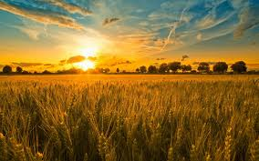
Then Jesus told them a parable…
“There was a rich man whose land produced a bountiful harvest. …

Slide 4
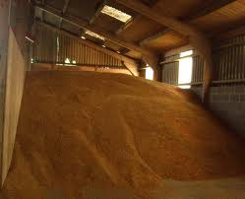
“What am I to, do? I have not enough room to store my crops.”

Slide 5
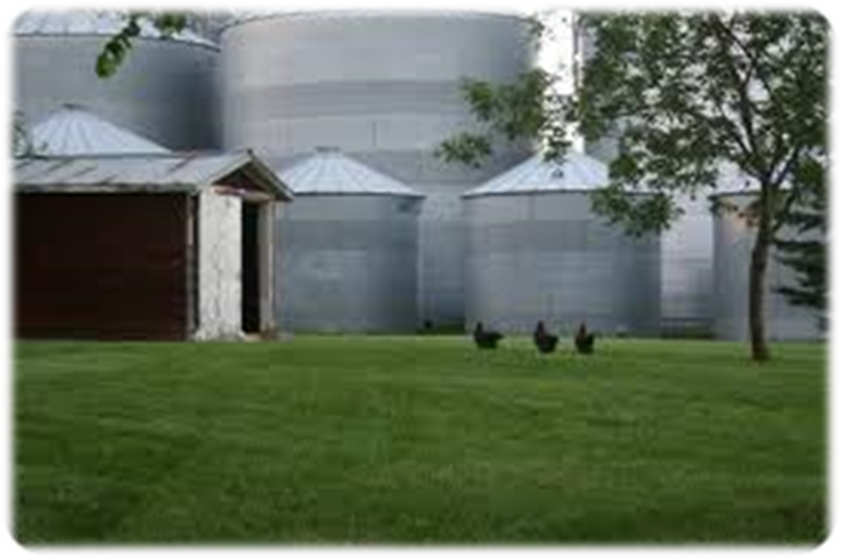
I will pull down my barns and build bigger ones, and store all my grain and my goods in them …

Slide 6
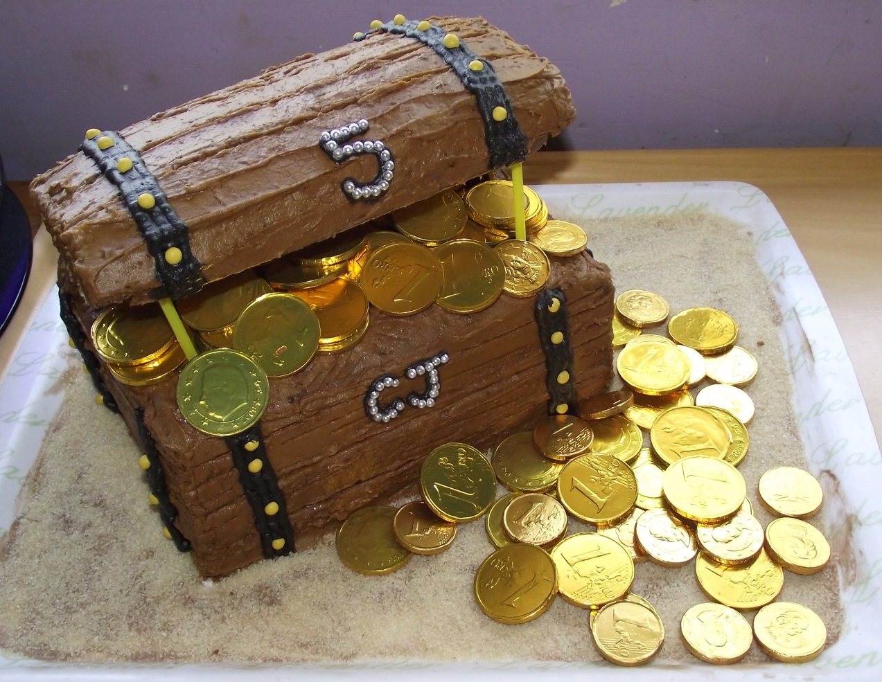
What treasures are you storing
up for yourself?

Slide 7
Please Stand

Slide 8
This slide is hidden.
Insert the Entrance Hymn after this slide

Slide 9
Priestly People
Priestly people, kingly people
Holy people, God's chosen people
Sing praises to the Lord

Slide 10
We sing to you
O Christ beloved Son of the Father
We give you praise
O Wisdom everlasting and Word of God

Slide 11
Priestly people, kingly people
Holy people, God's chosen people
Sing praises to the Lord

Slide 12
We sing to you
O Son born of Mary the Virgin
We give you praise
Our Brother born to heal our saving Lord

Slide 13
Priestly people, kingly people
Holy people, God's chosen people
Sing praises to the Lord

Slide 14
We sing to you
O brightness of splendour and glory
We give you praise
O Morning Star announcing the coming day

Slide 15
Priestly people, kingly people
Holy people, God's chosen people
Sing praises to the Lord

Slide 16
We sing to you
O light bringing us out of darkness
We give you praise
O guiding light who shows us the way to heaven

Slide 17
Priestly people, kingly people
Holy people, God's chosen people
Sing praises to the Lord

Slide 18
We sing to you
Messiah foretold by the prophets
We give you praise
O Son of David and Son of Abraham

Slide 19
Priestly people, kingly people
Holy people, God's chosen people
Sing praises to the Lord

Slide 20
We sing to you
Messiah the hope of the people
We give you praise
O Christ our Lord and King , humble, meek of heart

Slide 21
Priestly people, kingly people
Holy people, God's chosen people
Sing praises to the Lord

Slide 22
We sing to you
The way to the Father in heaven
We give you praise
The way of truth and way of all grace and light

Slide 23
Priestly people, kingly people
Holy people, God's chosen people
Sing praises to the Lord

Slide 24
We sing to you
O Lamb put to death for the sinner
We give you praise
O victim immolated for humankind

Slide 25
Priestly people, kingly people
Holy people, God's chosen people
Sing praises to the Lord

Slide 26
We sing to you
The tabernacle made by the Father
We give you praise
The cornerstone and saviour of Israel

Slide 27
Priestly people, kingly people
Holy people, God's chosen people
Sing praises to the Lord

Slide 28
We sing to you
The shepherd wh leads to the kingdom
We give you praise
Who gather all your sheep in the one true fold

Slide 29
Priestly people, kingly people
Holy people, God's chosen people
Sing praises to the Lord

Slide 30
We sing to you
O fount overflowing with mercy
We give you praise
Who give us living waters to quench our thirst

Slide 31
Priestly people, kingly people
Holy people, God's chosen people
Sing praises to the Lord

Slide 32
We sing to you
True vine planted by God our Father
We give you praise
O blessed vine whose branches bear fruit in love

Slide 33
Priestly people, kingly people
Holy people, God's chosen people
Sing praises to the Lord

Slide 34
We sing to you
The manna which God gives all people
We give you praise
O living bread which comes down to us from heaven

Slide 35
Priestly people, kingly people
Holy people, God's chosen people
Sing praises to the Lord

Slide 36
We sing to you
The image of the Father eternal
We give you praise
O king of justice, Lord and the king of peace

Slide 37
Priestly people, kingly people
Holy people, God's chosen people
Sing praises to the Lord

Slide 38
We sing to you
The first born of all God's creation
We give you praise
Salvation of your saints sleeping in the Lord

Slide 39
Priestly people, kingly people
Holy people, God's chosen people
Sing praises to the Lord

Slide 40
We sing to you
O Lord whom the Father exalted
We give you praise
In glory you are coming to judge all people

Slide 41
Priestly people, kingly people
Holy people, God's chosen people
Sing praises to the Lord

Slide 43
Confiteor
I confess to almighty God
And to you, my brothers and sisters,
That I have greatly sinned
In my thoughts and in my words

Slide 44
In what I have done
And in what I have failed to do,
Through my fault,
Through my fault,
Through my most grievous fault;

Slide 45
Therefore I ask blessed Mary ever-Virgin,
All the Angels and Saints,
And you, my brothers and sisters,
To pray for me to the Lord our God.

Slide 47
Kyrie eleison
Kyrie eleison (2)
Christe eleison (2)
Kyrie eleison (2)

Slide 49
Gloria
Glory to God in the highest,
and on earth peace to people of good will.
We praise you, we bless you,
we adore you, we glorify you,

Slide 50
We give you thanks for your great glory,
Lord, God heavenly king,
O God, almighty father

Slide 51
Glory to God in the highest,
and on earth peace to people of good will.

Slide 52
Lord Jesus Christ, Only Begotten Son,
Lord God, Lamb of God, Son of the Father,
you take away the sins of the world,
have mercy on us;

Slide 53
you take away the sins of the world, receive our prayer;
you are seated at the right hand of the Father,
have mercy on us.

Slide 54
Glory to God in the highest,
and on earth peace to people of good will.

Slide 55
For you alone are the Holy One,
you alone are the Lord,
you alone are the Most High, Jesus Christ,
with the Holy Spirit,
in the glory of God the Father.

Slide 56
Glory to God in the highest,
and on earth peace to people of good will.
Amen.

Slide 58
Responsorial Psalm
In every age O Lord, you have been our refuge

Slide 60
Corpus Christi
Sing forth, O Zion, sweetly sing
The praises of thy Shepherd-King,
In humns and canticles divine;
Dare all thou canst, thou hast no song
Worthy his praises to prolong,
So far surpassing powers like thine

Slide 61
Today no theme of common praise
Forms the sweet burden of thy lays
The living, life-dispensing food
That food which at the sacred board
Unto the brethren twelve our Lord
His parting legacy bestowed

Slide 62
Then be the anthem clear and strong,
Thy fullest note, thy sweetest song,
The very music of the breast;
For now shines forth the day sublime
That brings remembrance of the time
When Jesus first his table blessed.

Slide 63
Within our new King's banquet-hall
They meet to keep the fetival
That closed the ancient pascal rite
The old is by the new replaced;
The substance hath the shadow chased;
And rising day dispels the night

Slide 64
Christ willed what he himself had done
Should be renewed while time should run,
In memory of his passing hour
Thus tutored in his school divine
We consecrate the bread and wine
And lo! A host of saving power

Slide 65
This faith to Christian men is given
Bread is made flesh by words from heaven
Into his blood the wine is turned
What though it baffles nature's powers
Of sense and sight? This faith of ours
Proves more than nature e'er discerned

Slide 66
Concealed beneath the twofold sign
Meet symbols of the gifts divine
There lie t emysteries adored
The living body is our food
Our drink the ever-precious blood
In each, one undivided Lord

Slide 67
Not he that eateth it divides
The sacred food, which whole abides
Unbroken still, nor knows decay
Be one, or be a thousand fed
They eat alike that living bread
Which, still received, n'er wastes away

Slide 68
The good, the guilty share therein
With sure increase of grace or sin
The ghostly life or ghostly death
Death to the guilty; to the good
Immortal life. See how one food
Man's joy or woe accomplisheth.

Slide 69
We break the sacrament; but bold
And firm thy faith shall keep its hold
Deem not the whole doth more enfold
Than in the fractured part resides
Deem not that Christ doth broken lie;
Tis but the sign that meets the eye
The hidden deep leality in all it's fullness still abides

Slide 70
Behold the bread of angels, sent
For pilgrims in their banishment
The bread for God's true children meant
That may not unto dogs be given
Oft in the olden types foreshadowed
In Isaac on the altar bowed
And in the ancient pascal food
And in manna sent from heaven

Slide 71
Come then, good shepherd, bread divine
Still show to us thy mercy sign
O feed us still, still keep us thine
So we may see thy glories shine
In fields of immortality

Slide 72
O thou, the wisest, mightiest, best
Our present food, our future rest
Come, make us each thy chosen guest
Co-heirs of thine, and comrades blest
With saints whose dwelling is with thee

Slide 74
Alleluia
Alleluia, alleluia,
alleluia, alleluia

Slide 76
Apostles Creed
I believe in God,
the Father almighty,
Creator of heaven and earth,
and in Jesus Christ, his only Son, our Lord,
(At the words that follow, up to and including the Virgin Mary, all bow.)

Slide 77
who was conceived by the Holy Spirit,
born of the Virgin Mary,
suffered under Pontius Pilate,
was crucified, died and was buried;
he descended into hell;

Slide 78
on the third day he rose again from the dead;
he ascended into heaven,
and is seated at the right hand of God the Father almighty;

Slide 79
from there he will come to judge the living and the dead.
I believe in the Holy Spirit,
the holy catholic Church,

Slide 80
the communion of saints,
the forgiveness of sins,
the resurrection of the body,
and life everlasting.
Amen.

Slide 82
First Collection
This collection goes to the Bishop
for the support of the Diocese.
Thank you for your contribution

Slide 84
This slide is hidden.
Insert the Offertory Hymn after this slide.

Slide 85
Santo
Santo, santo, santo
Mi corazon te adora
Mi corazon te sabe decir
Santo eres senor

Slide 86
Santo, santo, santo
Mi corazon te adora
Mi corazon te sabe decir
Santo eres senor

Slide 87
Santo, santo, santo
Mi corazon te adora
Mi corazon te sabe decir
Santo eres senor

Slide 88
Holy, holy, holy
My heart, my heart adores you
My heart is glad to say the words
You are holy Lord
You are holy Lord

Slide 90
Priest: Pray my brothers and sisters,
that my sacrifice and yours may be
acceptable to God, the almighty Father.
All: May the Lord accept the sacrifice
at your hands for the praise and glory of his name, for our good and the good of all his holy Church.

Slide 91
Priest: The Lord be with you.
All: And with your spirit.
Priest: Lift up your hearts.
All: We lift them up to the Lord.

Slide 92
Priest: Let us give thanks to the
Lord our God.
All: It is right and just.

Slide 94
Holy
Holy, Holy, Holy Lord God of hosts,
Heaven and earth are full of your glory. Hosanna in the highest
Blessed is he who comes
in the name of Lord,
Hosanna in the highest.

Slide 96
Memorial acclamation
Save us saviour of the world,
For by your cross and resurrection,
You have set us free

Slide 97
Memorial acclamation
When we eat this bread
And drink this cup
We proclaim your death O Lord
Until you come again

Slide 98
Memorial acclamation
We proclaim your death O Lord
And profess your resurrection
Until you come again

Slide 100
Amen
Amen, amen, amen, amen.
Amen, amen, amen, amen.

Slide 102
Priest: The Lord be with you.
All: And with your spirit

Slide 104
Peace
May the peace of the Lord be with you
With your friends and your family too
Let it be, let it grow
And everywhere you go
May the peace of the Lord follow you

Slide 105
Lamb of God
Lamb of God, lamb of God
You take away the sins of the world
Have mercy on us, lamb of God

Slide 106
Lamb of God, lamb of God
You take away the sins of the world
Have mercy on us, lamb of God

Slide 107
Lamb of God, lamb of God
You take away the sins of the world
Grant us, grant us peace

Slide 109
Priest: Behold the Lamb of God, behold him
who takes away the sins of the world.
Blessed are those called to the supper of the Lamb.
All: Lord, I am not worthy
that you should enter under my roof,
but only say the word
and my soul shall be healed.

Slide 110
This slide is hidden.
Insert the Communion Hymns after this slide.

Slide 111
Panis Angelicus
Panis angelicus
Fit panis hominum
Dat panis coelicus
Figuris terminum

Slide 112
O res mirabilis
Man ducat Dominum
Pauper, pauper
Servus et humilis

Slide 113
Pauper, pauper
Servus et humilis

Slide 114
Panis angelicus
Fit panis hominum
Dat panis coelicus
Figuris terminum

Slide 115
O res mirabilis
Man ducat Dominum
Pauper, pauper
Servus et humilis

Slide 116
Pauper, pauper
Servus, servus et humilis

Slide 117
Ave Maria
Ave Maria, gratia plena
Dominus tecum,
Ave Maria

Slide 118
Benedicta tu
Benedicta tu in mulieribus
Et benedictus
Fructus ventris tui Jesus

Slide 119
Ave Maria,
Ave Maria

Slide 120
Santa Maria
Mater dei
Ora pro nobis peccatoribus

Slide 121
Nunc et in hora
Mortis nostrae amen

Slide 122
Ave Maria
Ave Maria
Ave

Slide 124
Second Collection
What you contribute now
is for the support of our
parish and its mission.
Thank you for your generosity

Slide 125
This slide is hidden.
Insert the Notices for the week after this slide

Slide 126
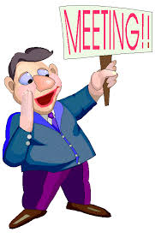
Parish Pastoral Council PPC
Wednesday, 7 August at 7.30pm in
Parish Meeting Room (Office)

Slide 127

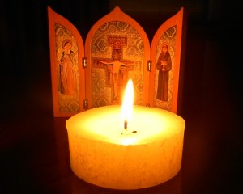
Wednesday 7 August – St Michael’s
6.30pm Holy Hour
7.30pm Mass
8.00pm Supper
National Vocations Awareness Week Aug 4 –11

Slide 128
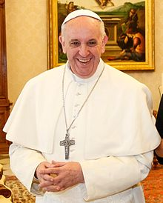
Pope Francis’
Prayer for Vocations
God our Father,
You make each of us
to use our gifts in the Body of Christ.
We ask that you inspire young people
whom you call to priesthood
and consecrated life
to courageously follow your will.
.

Slide 129
Send workers into your great harvest
so that the Gospel is preached,
the poor are served with love,
the suffering are comforted,
and Your people are strengthened
by the sacraments.
We ask this through Christ our Lord.
Amen

Slide 130

Please take home your bulletins or download it from
www.stmichaelsparish.com
  www.facebook.com/blacktowncatholics

Slide 131
This slide is hidden.
The next slide can be used for videos.
Insert the video into the slide.

Slide 133
Priest: The Lord be with you.
All: And with your spirit.

Slide 135
This slide is hidden.
Insert the Recessional Hymns after this slide.

Slide 136
Tu es Sacerdos
Tu es Sacerdos, in aeternum,
Secundum ordinem Melchisedech

Slide 137
Juravit Dominus
Juravit Dominus
Juravit, juravit Dominus

Slide 138
Et non poeni tebit eum
Et non poeni tebit eum
Et non poeni tebit eum

Slide 139
Tu es Sacerdos, in aeternum
Tu es Sacerdos in aeternum
Tu es Sacerdos, tu es Sacerdos
In aeternum
Alleluia

Slide 141
This slide is hidden.
Insert the final slide here.

Slide 142
What treasures are you storing
up for yourself?

